Slide 1
School Dropout Prediction Project
Predicting School Dropouts Using Machine Learning
Presented by: Blessing Ilesanmi
Date: 25th October, 2024

Slide 2
Project Overview
Business Problem
Goal: Develop a predictive model to identify students at risk of dropping out.
Objective: Provide early intervention to reduce school dropout rates using data insights.
Why Dropout Prediction Matters:
Dropouts affect individual future success and society (unemployment, poverty).
Early identification enables educators to take proactive actions.

Slide 3
Dataset Overview
Data Source: 3Signet
Key Features:
Previous Qualification Grade
1st and 2nd Semester Curriculum details
Financial Data: Debtor, Scholarship holder, e.t.c
Age at enrollment

Slide 4
Exploratory Data Analysis (EDA)
Key Insights:
Students with higher previous qualifications are less likely to drop out than those with lower qualifications.
Dropout rates are lower among students receiving financial aid or scholarships
Students who are debt-free have lower dropout rates compared to those with outstanding debts.
Students with up-to-date tuition payments are less likely to drop out compared to those with overdue payments.

Slide 5
Modelling Approach
Problem Type: Classification
Algorithms Tested:
Logistic Regression
Decision Tree
Random Forest
XGBoost
Support Vector Machine (SVM)

Slide 6
Model Performance
Evaluation Metrics: Accuracy, Precision, Recall, F1-Score.
Logistic Regression 0.760452 0.743781 0.760452 0.743407 0.875942
Decision Tree 0.696045 0.698928 0.696045 0.697114 0.737039
Random Forest 0.767232 0.752062 0.767232 0.753082 0.873943
Support Vector Machines 0.749153 0.736490 0.749153 0.735353 0.876137
XGBoost 0.771751 0.758692 0.771751 0.762171 0.872406

Slide 7
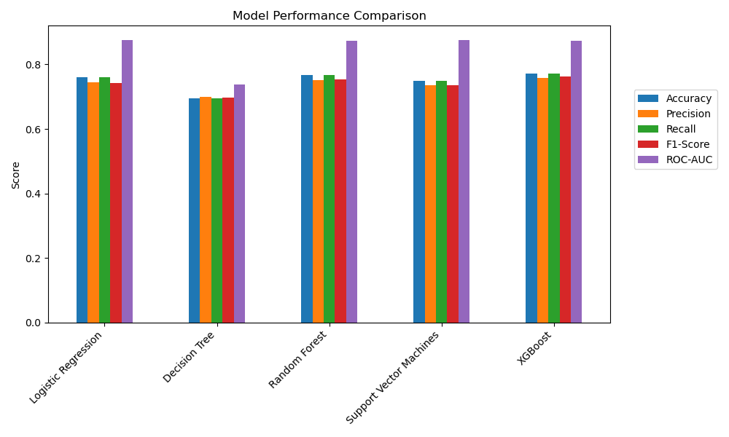

Slide 8
Model Performance
Evaluation Metrics: Cross-validation.
Logistic Regression CV Accuracy: 0.7577
Decision Trees CV Accuracy: 0.6756
Random Forests CV Accuracy: 0.7690
Support Vector Machines CV Accuracy: 0.7476
XGBoost CV Accuracy: 0.7540

Slide 9
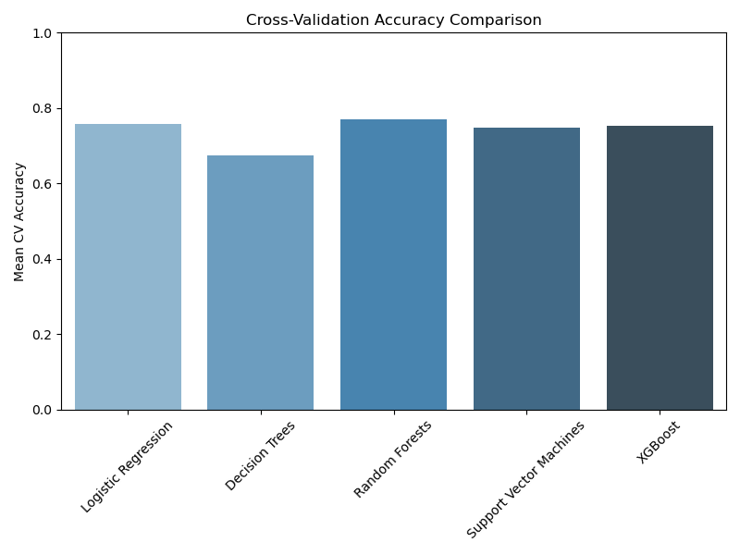

Slide 10
Final Model Selection
Best Model: Random Forest with 77% accuracy
Chosen Model: Random Forest
Why:
High interpretability and feature importance analysis.
Good balance of accuracy and recall.

Slide 11
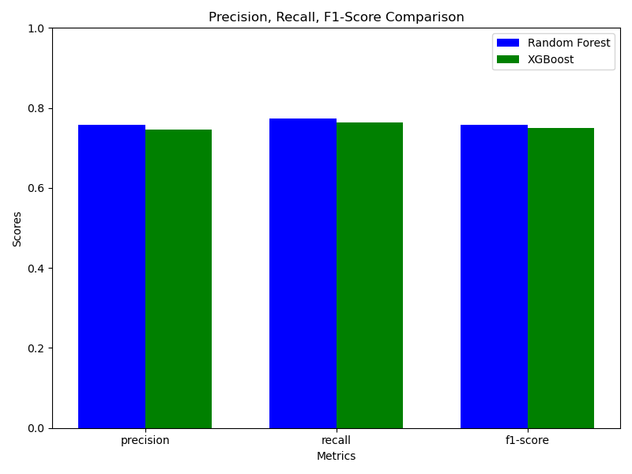

Slide 12
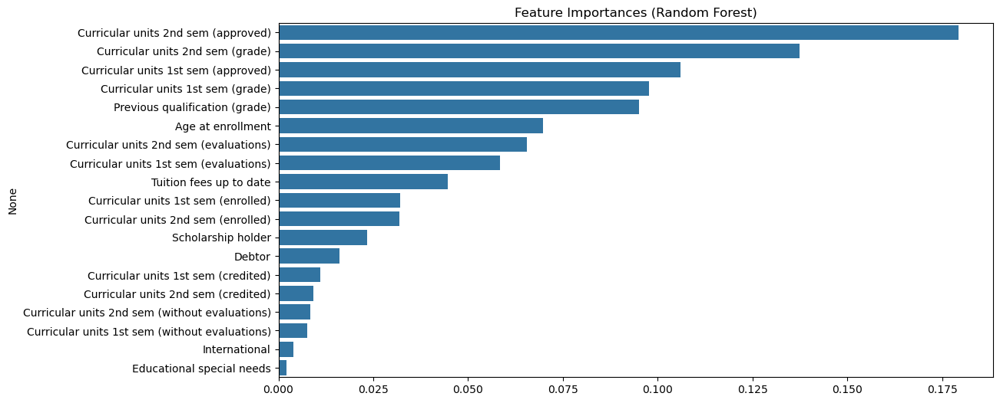

Slide 13
Deployment – Streamlit Web App Live Demo

Slide 14
Conclusion
Summary: Dropout prediction model identifies at-risk students early for timely intervention.

Slide 15
Thank You

